Slide 1
SECURE DATA HIDING IN IMAGES USING STEGANOGRAPHY
CAPSTONE PROJECT
Presented By:
Student Name : Aman Gupta
College Name & Department : Microtek College of Management and Technology, BCA Department

Slide 2
OUTLINE
Problem Statement
Technology used
Wow factor
End users
Result
Conclusion
Git-hub Link
Future scope

Slide 3
Problem Statement
I first saved the password inside the picture itself when I was putting the encryption method into practice. However, because the system was unable to distinguish between the encrypted message and the stored password, this method caused problems during decryption. In order to address this, I created a distinct secure.txt file to safely store passwords, enabling error-free and seamless decryption.

Slide 4
Technology used
Programming Language: Python
Libraries Used: OpenCV (cv2), os, string
Platform: Windows

Slide 5
Wow factors
Secure Password Storage: Instead of embedding the password within the image, it is stored in a separate file for better security.
Enhanced Decryption Process: Eliminates confusion between encrypted message and password.
User-Friendly Implementation: Easy encryption and decryption without complex setups.

Slide 6
End users
Individuals who need to send secure messages.
Organizations looking for simple, image-based encryption techniques.
Students & Developers interested in learning encryption methods.

Slide 7
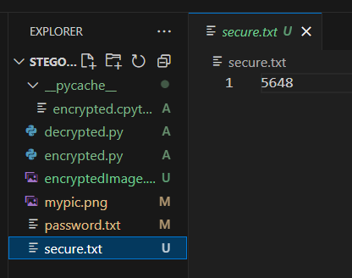
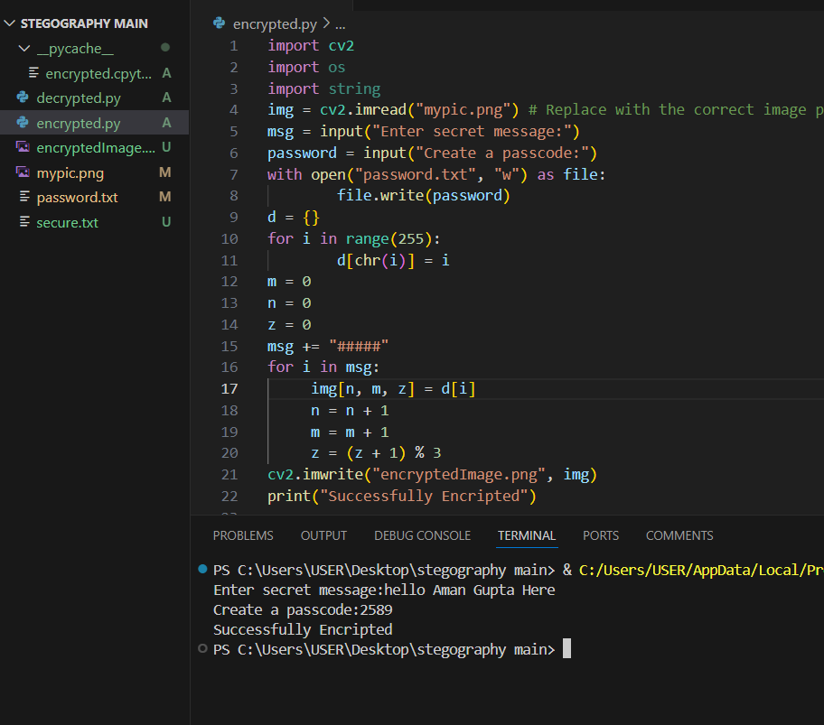
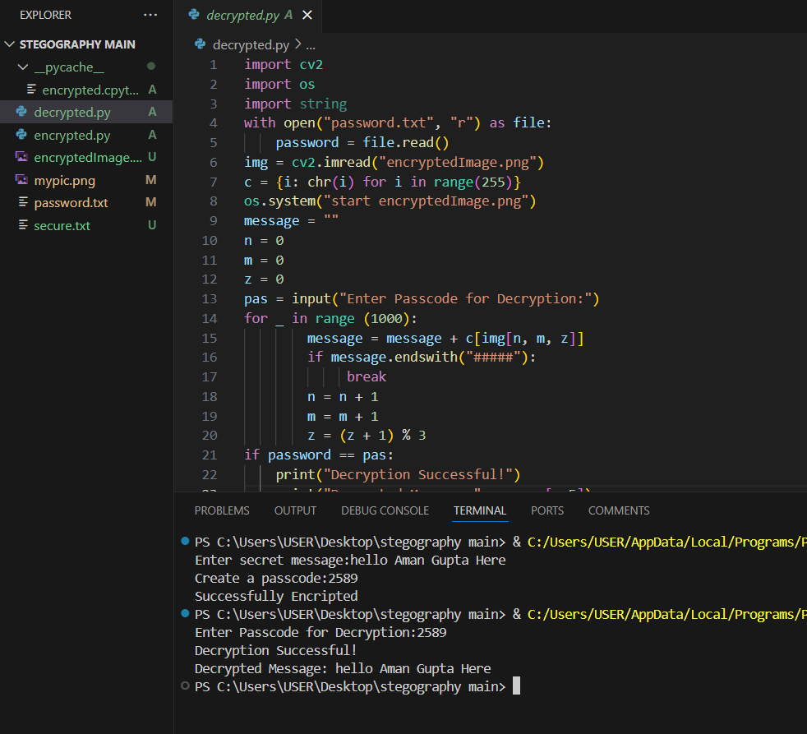
Results

Slide 8
Conclusion
By implementing a separate password storage system, the encryption and decryption process has become more secure and reliable. The project effectively addresses the challenge of securely transmitting messages using images without confusion in password retrieval.

Slide 9
GitHub Link
https://github.com/Amang2443/Steganography.git

Slide 10
Future scope(optional)

Slide 11
THANK YOU

